Slide 1
Signals and Systems
Wang Lingfang (王玲芳)
(School of Optoelectronic Science and Engineering, UESTC)
Email：lf.wang@uestc.edu.cn
Sep.2021----- Jan. 2022

Slide 2
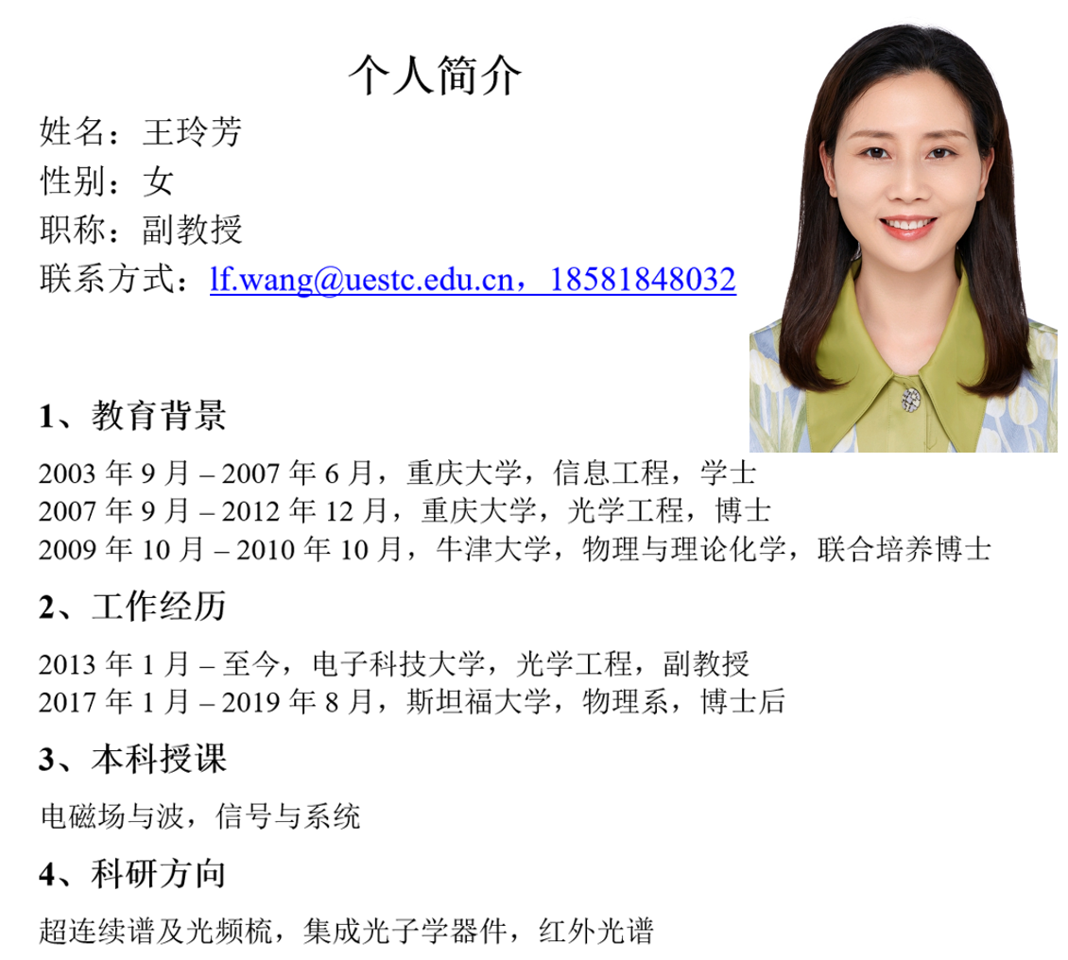


Signals and Systems

Slide 3

Signals and Systems
Rain Classroom 雨课堂-2021秋季班

Slide 4
Signals and Systems
Teaching assistant
1. Shi Xin(时鑫)：E-mail: 2680352529@qq.com
2. Chen Hong(陈红)：15730743525
3. Huang Mengjie:（黄孟杰） in QQ group
Time for question ：To be decided
Location：Room 204
Research Building B

Slide 5
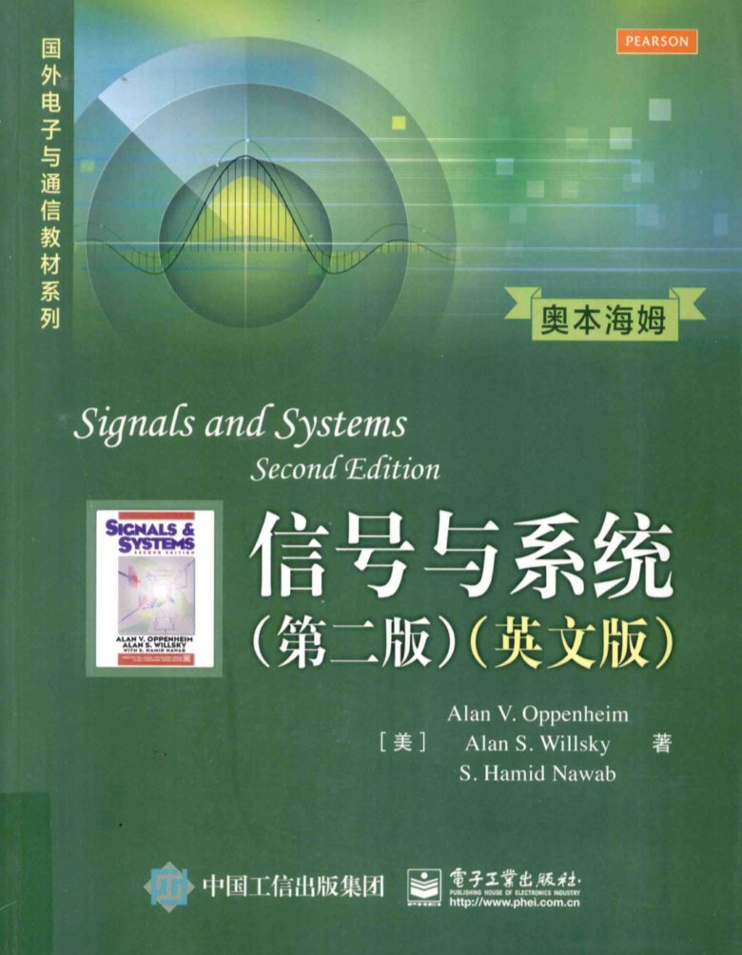
Signals and Systems
Signals and Systems(Second Edition)
Alan V. Oppenheim
Alan S. Willsky (M.I.T)
S. Hamid Nawab (B.U.)
References
[1] 郑君里，应启珩，杨为理，信号与系统(第二版)，北京：高等教育出版社，2000年
[2] 闵大镒，朱学勇，信号与系统分析，电子科技大学出版社，2000年
[3] 吕幼新，张明友，信号与系统，电子工业出版社，2003年
[4] MIT video course: http://open.163.com/newview/movie/free?pid=M8AROL7GG&mid=M8AROOU9F

Slide 6
Assessment
Signals and Systems
5% homework and class
sign in and class tests.
20% laboratory work (report, presentations and demonstrations)
20% mid-term exam (2 hours)
55% final exam (2 hours)

Slide 7

Multiple Choice(single)
Points: 1
Sign-In Please
A
I am already in the classroom
B
Submit

Slide 8
Contents
1 Signals and Systems
2 Linear Time-Invariant Systems
3 Fourier Series Representation of Periodic Signals
(3.0~3.5 3.6 3.7 3.8 3.9 3.10，3.11 )
4 The Continuous-Time Fourier Transform
5 The Discrete-Time Fourier Transform (5.0~5.5 5.6~5.8 )
6 Time and Frequency Characterization of Signals and Systems
(6.1~6.4 6.5~6.7 )
7 Sampling (7.1 ~ 7.3 7.4--7.5 )
8 Communication System (8.1 8.2 8.3--8.8 )
9 The Laplace Transform
10 The Z-Transform
Note: Contents -- Keypoints.
Contents -- Read by yourselves.

Slide 9
Foreword
What are signals?—Functions of 1 or more independent variables, contain information
What are systems?---respond to particular signals by producing other signals or some desired behaviors
How do they work?

Slide 10
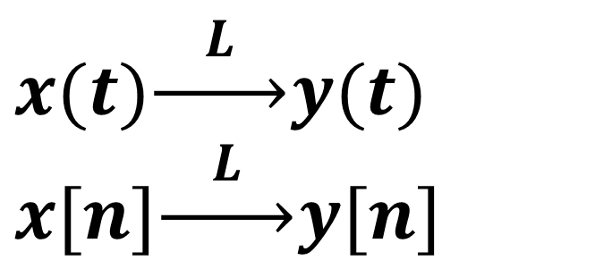
Foreword
Exciting
Response
System
(input signal)
(output signal)
$$x(t)\underset{→}{ L }y(t) \\ x[n]\underset{→}{ L }y[n]$$

Slide 11
Foreword
Example. Communication
Radio
signal
Received
signal
input
signal
output
signal
Transmitter
Receiver
intermediate
Text,
Audio,
Video
Text,
Audio,
Video
Electric,
Electromagnetic
With Information

Slide 12
Foreword
What shall we study?
---The concepts and techniques of signals and systems analysis
Why shall we study?
---Extraordinarily wide variety of applications

Slide 13
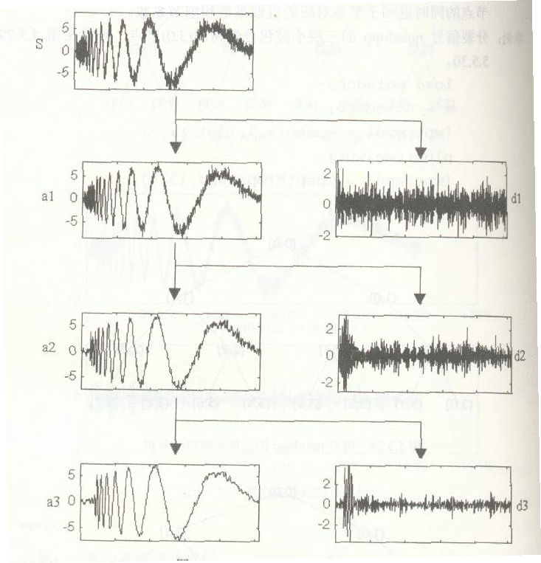
Foreword
Filter the noise
Get the edge of a picture

Slide 14
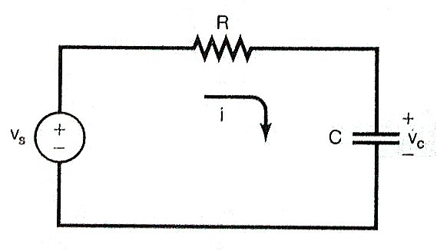
1 Signal and System
1. Signals and Systems
1.1 Continuous-time and discrete-time signals
1.1.1 Examples and Mathematical Representation
A. Examples
(1) A simple RC circuit
Source voltage Vs and
Capacitor voltage Vc

Slide 15
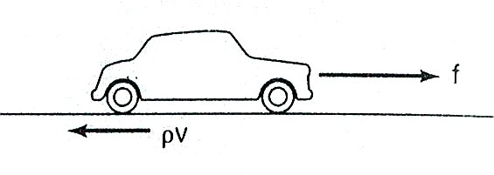
1 Signal and System
(2) An automobile
Force f from engine, f Regarding frictional force ρV
Velocity V

Slide 16
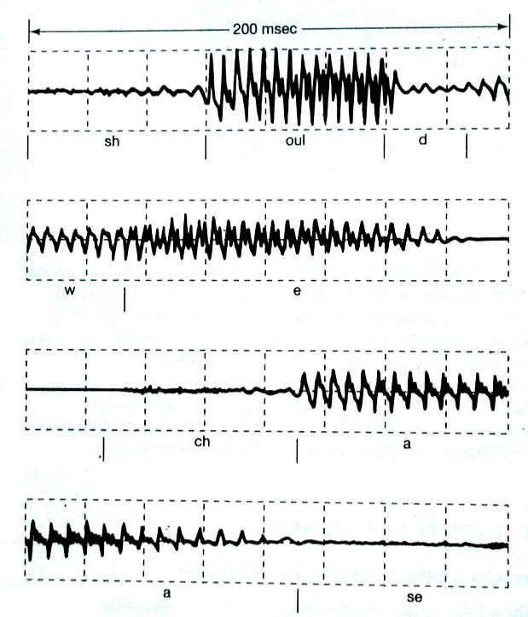
1 Signal and System
(3) A speech signal3) A Speech Signal

Slide 17
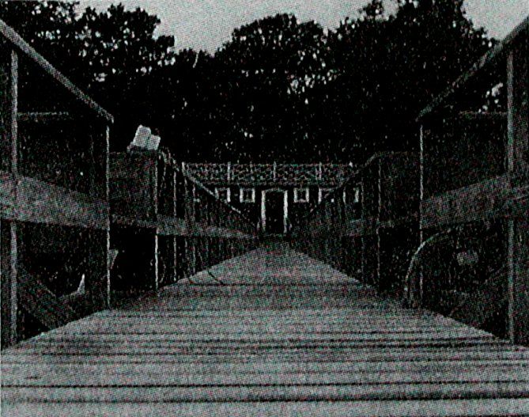
1 Signal and System
(4) An image signal

Slide 18
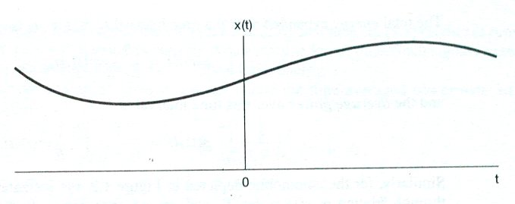
1 Signal and System
B. Types of Signals
(1) Continuous-time Signal

Slide 19
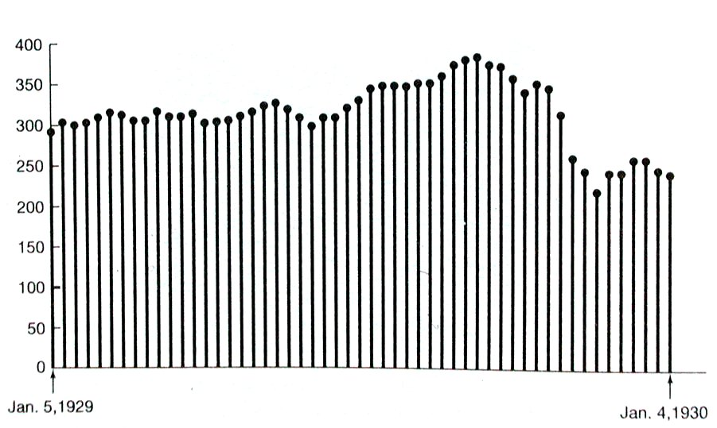
1 Signal and System
(2) Discrete-time Signal

Slide 20
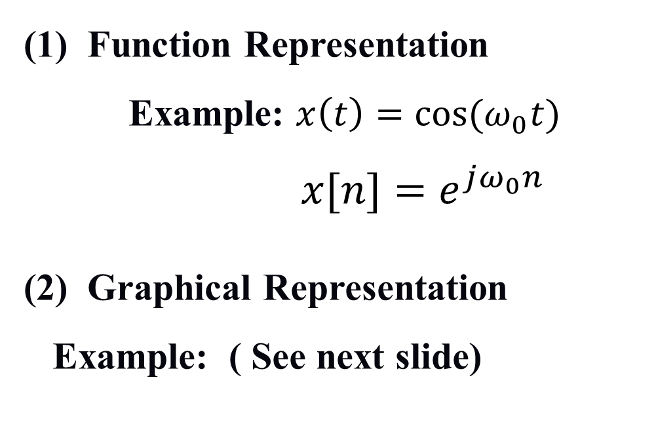
1 Signal and System
C. Representation
(1) Function Representation
Example: $x\left(t\right)=cos⁡(ω_{0}t)$
$x[n]=e^{jω_{0}n}$
(2) Graphical Representation
Example: ( See next slide)

Slide 21

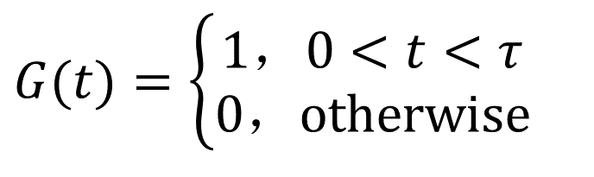

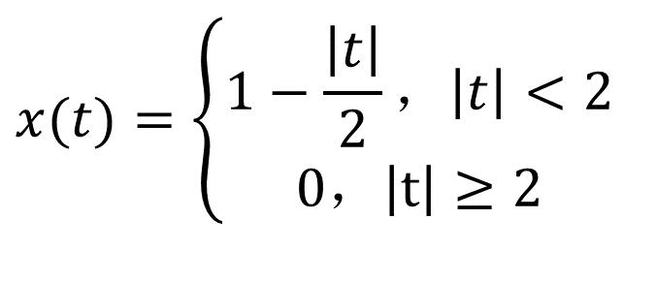

1 Signal and System
$$x(t)=\left\{\begin{matrix}1−\frac{\left|t\right|}{2}，\left|t\right|<2 \\ 0，\left|t\right|≥2\end{matrix}\right.$$
G(t)
$$G(t)=\left\{\begin{matrix}1，0<t<τ \\ 0，otherwise\end{matrix}\right.$$
$$1$$
t
$$0$$
$$τ$$

Slide 22
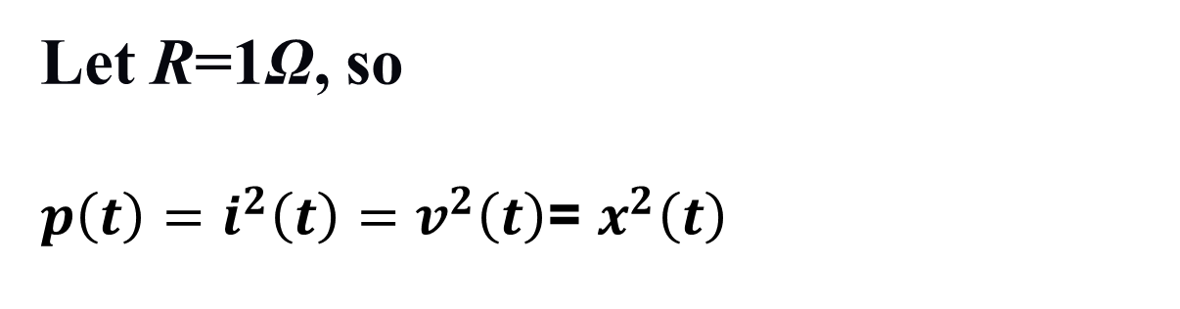
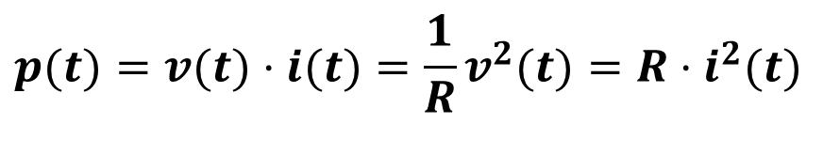
1 Signal and System
1.1.2 Signal Energy and Power
A. Energy (Continuous-time)
Instantaneous power:
$$p(t)=v(t)⋅i(t)=\frac{1}{R}v^{2}(t)=R⋅i^{2}(t)$$
Let R=1Ω, so
$p\left(t\right)=i^{2}\left(t\right)=v^{2}\left(t\right)$= $x^{2}\left(t\right)$

Slide 23
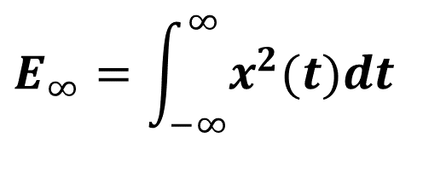
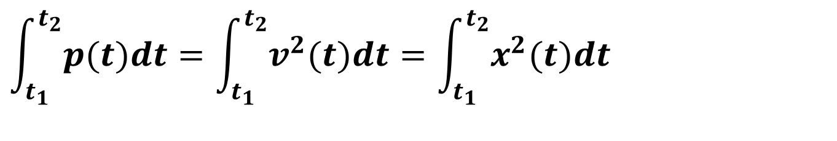
1 Signal and System
Energy over t₁≤ t ≤ t₂: for real x(t)
$$\int_{t_{1}}^{t_{2}}{p(t)dt}=\int_{t_{1}}^{t_{2}}{v^{2}(t)dt}=\int_{t_{1}}^{t_{2}}{x^{2}(t)dt}$$
Total Energy:
$$E_{∞}=\int_{−∞}^{∞}{x^{2}(t)dt}$$
Average Power:

Slide 24
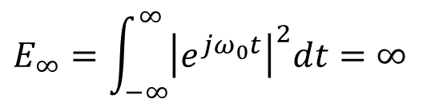
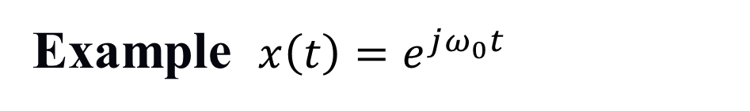
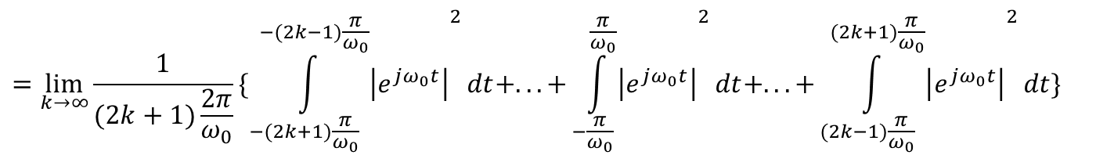
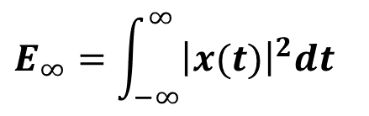
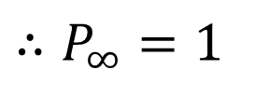
1 Signal and System
If x(t) is complex signal,
$$E_{∞}=\int_{−∞}^{∞}{{\left|x(t)\right|}^{2}dt}$$
Example ${x\left(t\right)=e}^{jω_{0}t}$
$$E_{∞}=\int_{−∞}^{∞}{{\left|e^{jω_{0}t}\right|}^{2}dt}=∞$$
Total Energy:
Average Power:
$$=\lim_{k→∞}{\frac{1}{(2k+1)\frac{2π}{ω_{0}}}}\{{\int_{−(2k+1)\frac{π}{ω_{0}}}^{−(2k−1)\frac{π}{ω_{0}}}{\left|e^{jω_{0}t}\right|}}^{2}dt+...+{\int_{−\frac{π}{ω_{0}}}^{\frac{π}{ω_{0}}}{\left|e^{jω_{0}t}\right|}}^{2}dt+...+{\int_{(2k−1)\frac{π}{ω_{0}}}^{(2k+1)\frac{π}{ω_{0}}}{\left|e^{jω_{0}t}\right|}}^{2}dt\}$$
$$∴P_{∞}=1$$

Slide 25
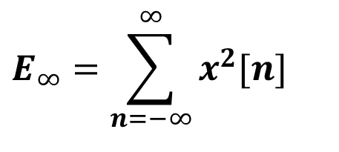
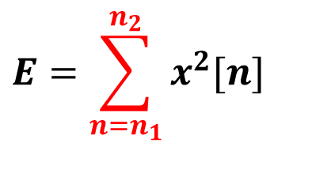
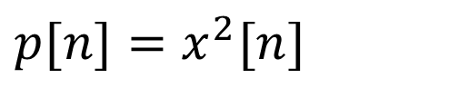
1 Signal and System
B. Energy (Discrete-time)
Instantaneous power:
$$p[n]=x^{2}[n]$$
$$E=\sum_{n=n_{1}}^{n_{2}}{x^{2}[n]}$$
Energy over n₁≤ n ≤ n₂:
$$E_{∞}=\sum_{n=−∞}^{∞}{x^{2}[n]}$$
Total Energy :
Average Power:

Slide 26

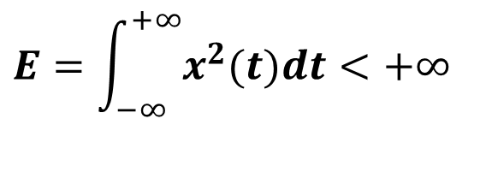
1 Signal and System
C. Finite Energy and Finite Power Signal
Finite Energy Signal :
( P → 0 )
$$E=\int_{−∞}^{+∞}{x^{2}(t)dt}<+∞$$
$$E=\sum_{n=−∞}^{+∞}{x^{2}[n]}<+∞$$
Finite Power Signal :
( E → ∞ )

Slide 27
1 Signal and System
1.2 Transformations of the Independent Variable
1.2.1 Examples of Transformations
t₀ >0, n₀>0
A. Time Shift
Right shift : x(t-t₀)
x[n-n₀] (Delay)
Left shift : x(t+t₀)
x[n+n₀] (Advance)

Slide 28
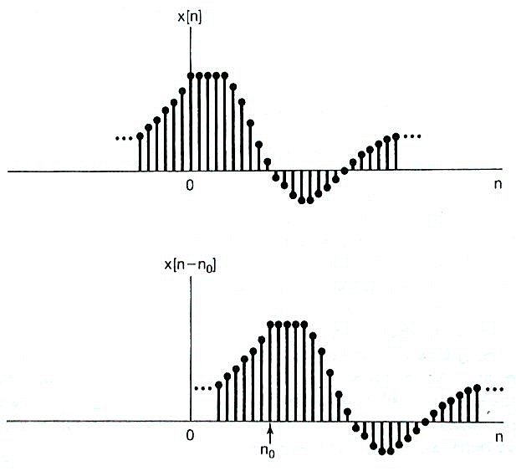
1 Signal and System
Examples

Slide 29
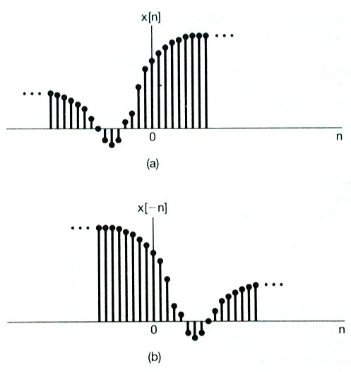
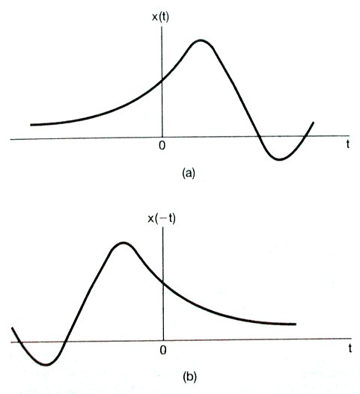
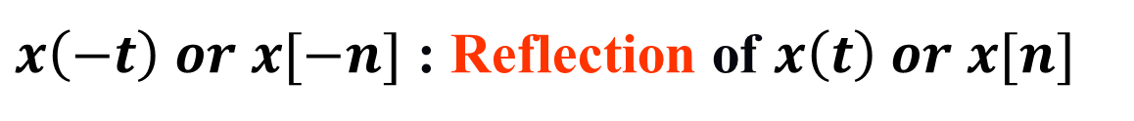
1 Signal and System
B. Time Reversal
$x\left(−t\right) or x[−n]$ : Reflection of $x\left(t\right) or x[n]$

Slide 30
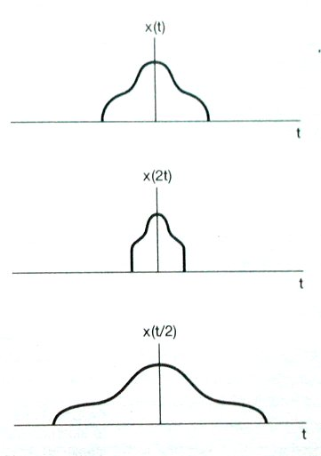
1 Signal and System
C. Time Scaling
1
x(at) ( a>0 )
-2
0
2
Example 1.1
1
Compressed if a>1
Stretch if a<1
-1
0
1
1
- 4
0
4

Slide 31
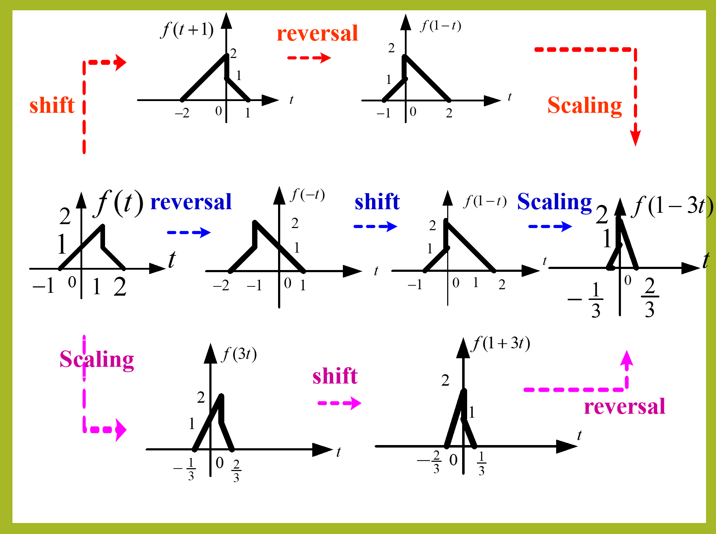
Open Question
Remark
Points: 0.5
Remark
{Test #1}: signal f(t) is shown in the figure, please sketch the signal f(1-3t).
?
Open Question is only supported on Version 2.0 or newer.
Answer
Text\Image\Formula are allowed and all the content should be placed in this area

Slide 32
reversal
shift
Scaling
reversal
shift
Scaling
Scaling
shift
reversal

